Slide 1

SAMSUNG PRISM
Generative AI
Hackathon
3rd Edition 2026 – 27
Theme ID - 05
Team Name - Autonomous Partners
College Name – SRM Institute of Science and Technology
Member Name & Email 1- Pavithra V G & pv2496@srmist.edu.in
Member Name & Email 2- Gawtham Prasath & gs3548@srmist.edu.in
Member Name & Email 3- Thenamudhan S & ts1255@gmail.com
Submission Github link -
Notes:
Opening slide for the 3rd edition of the PRISM Generative AI Hackathon. Replace the SAMSUNG PRISM pill with the official PRISM logo image if you have the asset. Confirm the academic year label (2026-27) before circulating.

Slide 2
Theme – 05
Interruptible Real-Time Agents
What the challenge asks
Our solution - KAIZEN's interpretation
• Keep the conversation alive while the agent reasons.
• Recover cleanly from mid-turn interruptions instead of restarting.
• Adapt when the user's goal changes without losing relevant session context.
• Build a reliable real-time agent structure, not just a chat wrapper.
• Full-duplex voice with real-time audio streaming.
• Barge-in handling that flushes speech and marks the turn interrupted.
• State-aware UI with idle / listening / reasoning / speaking / interrupted modes.
• Session-local memory vault + observer + learning loop keep context alive.

Slide 3
Existing Solutions & Gaps
Most assistants follow a linear loop: listen → think → speak.
A user interruption often breaks that loop.
Typical approach
What goes wrong
KAIZEN’s response
Turn-based voice
Waits for a turn to finish before adapting
Streams input/output and supports barge-in
Restart on change
Drops progress when the goal shifts
Preserves session state and routes the new intent
Passive context
Sees only the current utterance
Observer + local Vault add workflow context
One-shot learning
Answers disappear after the task
Voyager compiles solved workflows into reusable skills

Slide 4
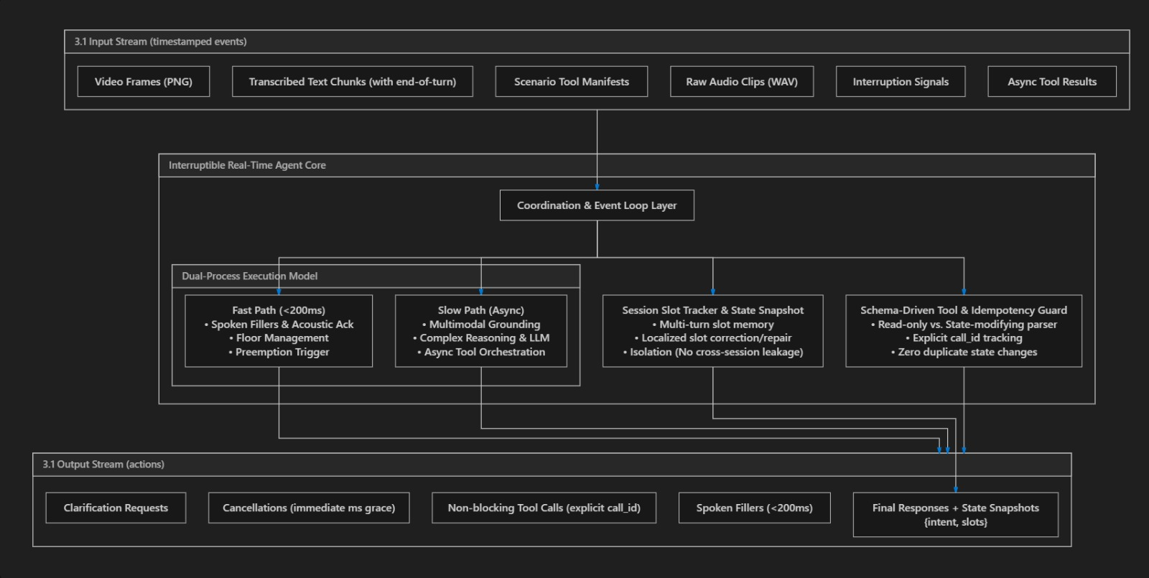
Our Solutions & Architecture Diagram

Slide 5
Demo & Product Walkthrough
YOUTUBE LINK FOR DEMO WALKTHROUGH :
https://youtu.be/15YEf9lTi2c?si=FnWbJ3V_XjJ6Mybw

Slide 6
Tools and tech stack used
Desktop
Electron 35
Frontend
React 19 + Vite 6
Native Windows app shell
TypeScript UI + real-time cockpit
Styling
Tailwind CSS 4
AI
Google GenAI SDK
Dense systems-style interface
Gemini Live + text generation
Realtime
WebSocket / PCM
Reasoning
Socratic + multi-agent
Bidirectional 16 kHz audio stream
Argument graph + deliberation
Context
Screenpipe observer
Memory
Local Vault
OCR/activity-informed intervention
Session memory + skill persistence
Integration
Google Workspace
Gmail, Drive & Tasks via OAuth

Slide 7
Impact & Use case
WHY IT MATTERS
Real-world use cases
User value
• Coding copilot that notices repeated errors or stagnation.
• Study partner that turns documents into guided Socratic learning.
• Research companion that keeps context while goals evolve.
• Desktop assistant that connects conversation to local workflows.
• Less conversational friction during natural speech.
• No hard reset when an interruption changes the goal.
• Context is retained within the session and local Vault.
• Resolved tasks can become reusable skills instead of one-off answers.
Design principle: the agent should yield instantly, remember what matters, and continue from the user's new intent.

Slide 8
Innovation highlights, results and limitations
01
Interruptibility
Gemini Live session forwards audio in both directions and exposes an interrupted event to the UI.
02
Resilience
Fallback model cascade and offline responses reduce abrupt conversation failure.
03
Context awareness
Screenpipe supervisor can trigger proactive intervention from stagnation/error signals.
04
Reasoning depth
Socratic graph + Teacher–Critic–Student deliberation separate analysis from the spoken answer.
05
Lifelong learning
Voyager turns solved engineering workflows into versioned Vault skills.
LIMITS
Current prototype is local-first but still depends on Gemini connectivity for full cloud reasoning; observer signals and workflow actions are prototype integrations rather than a production automation layer.

Slide 9
What’s next
01
02
03
WORKSPACE
CONNECTION
LOCAL BRAIN
SKILL LEARNING
Connect Gmail, Drive & Tasks to bring everyday work context directly into KAIZEN.
Obsidian-powered note taking for capturing, organizing and recalling knowledge locally.
Learn from completed tasks and convert successful workflows into reusable skills.
OUR VISION
CONNECT → REMEMBER → LEARN → EVOLVE

Slide 10
Brownie points slide
what makes KAIZEN different
Interrupts are a first-class event
Not a UI trick: barge-in changes agent state and the live stream.
Reasoning before speaking
Teacher–Critic–Student deliberation produces a refined answer before vocalization.
Proactive, not passive
Screenpipe can observe stagnation and initiate a contextual intervention.
Memory that compounds
Voyager converts solved workflows into reusable local skills.
Privacy by design
Local Vault + Electron isolation keep conversational memory on-device by default.

Slide 11
Checklist- Updated on Public GitHub
Working prototype code — public or shared GitHub repo (Y/N)
README with reproducible setup instructions (Y/N)
Demo video, max 5 minutes (YouTube or Drive link)
Presentation file (PPT or PDF) (Y/N)

Slide 12
Thank you
KAIZEN — Interruptible AI Partner
Samsung PRISM Generative AI Hackathon • Theme 05
Autonomous Partners • SRM Institute of Science and Technology
Organised by the Language AI Team and the PRISM Team, Samsung R&D Institute India
Notes:
Closing slide. Add the Google Form URL and a contact email before sharing. Edition 2 organising team for reference: Language AI - Sourabh Tiwari, Gaurav, Sanjeeth Pothireddy, Gorang Maniar; PRISM - Binny Lakra, Prakhar Chandrakar, Vishu Kumar; Kick-off and mentors - Giridhar Jakki, Deepraj Prabhakar Patkar (Language AI), Srimanu Prasad Nagaraju, Ashish Kumar (Tech Strategy).

